Slide 1
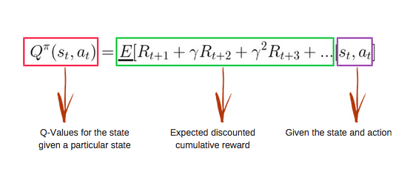
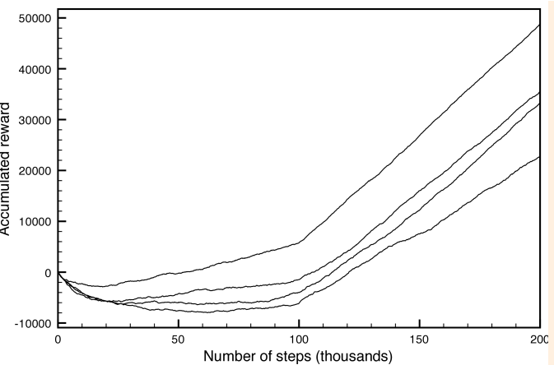
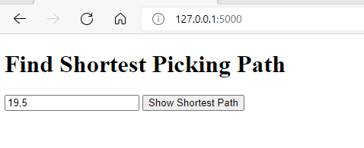
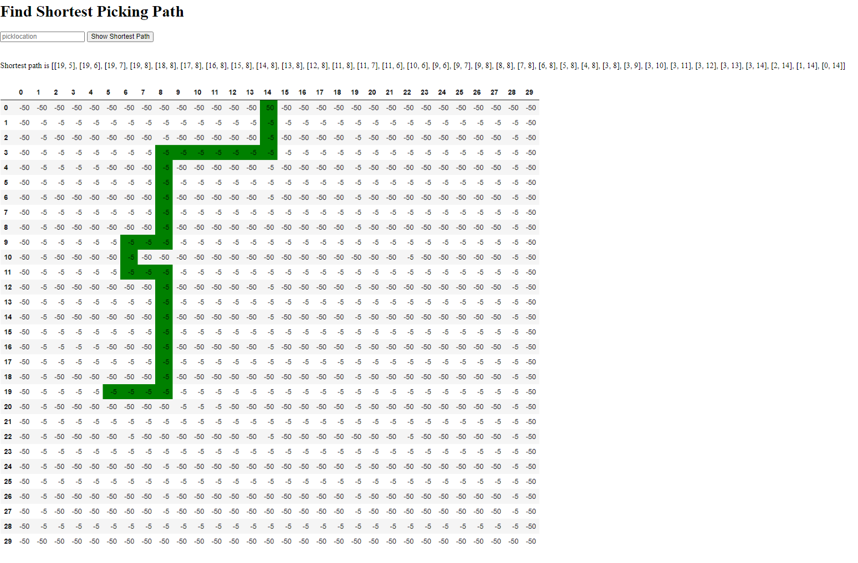
Advisor Name: Dr. Michele Bennett
Grand Canyon University
OPTIMIZING PICKING ROUTE FOR IMPROVING WAREHOUSE EFFICIENCY
Kannan Nova
Context and Background
The warehouse is a part of supply chain logistics industry where store the goods and bring back it from storage for shipment. Warehouse has two major core processes such as
Put away where download the goods from truck and place it into final location inside warehouse (McCrea, 2016).
Picking where take out the goods from final location and stuff into truck for shipping (Lopienski, 2020).
Based on literature reviews, the picking process is optimized by linearly or deterministic or deep learning, but it is dynamic and stochastic because goods can be placed anywhere in warehouse during put away/storing (Janse, 2019). Thus, these enable to use reinforcement Q-learning (RL) for optimizing the pricking process.
Components of Project - Model
Reinforcement Q-Learning Algorithm
Environment
Agent
States – Warehouse layout location
Actions
Rewards, Q-Tables
Bellman equation
Code
Index page, WMS.py, App.py, Requirements.txt
Performance graph between rewards vs steps
Implications
This project optimizes the efficiency of the warehouse picking operation by providing the shortest optimal path, and warehouse will ship the goods to consumer on time.
This will improve the overall warehouse efficiency and returns good ROI
Hardware and Software
Operating Systems: UNIX or Windows with RAM 32GB
Environment: Cloud or On-Premises
For visualizing the warehouse layout / structure: CAD floor software
GitHub for storing codes and maintaining versions.
Cloud: Google Cloud Provider (GCP) – App Engine.
Language: Python (version 3:8)
Python Libraries
dataframe-image==0.1.1, Flask==1.1.2, gunicorn==19.9.0,
numpy>=1.9.2, imagesize==1.2.0, imgkit==1.2.2, Jinja2==2.11.2,
joblib==1.0.1, json5==0.9.5, matplotlib>=1.4.3, pandas>=0.19,
Werkzeug==0.15.1, requests==2.24.0
Previews - UI and Output
UI
Output
The prediction results will be shown in text and visual representation as below
References
Bhatt, S. (2019, April 19). Reinforcement Learning 101. Medium. https://towardsdatascience.com/reinforcement-learning-101-e24b50e1d292.
Gillman, D. (2016, May 16). 5 Ways Machine Learning Improves Warehouse Operations. Retrieved from https://www.toolbox.com/tech/erp/blogs/5-ways-machine-learning-improves-warehouse-operations-051616
Janse, L., & Rensburg, V. (2019). Artificial Intelligence for warehouse picking optimization. – An NP-Hard Problem. Retrieved from http://uu.diva-portal.org/smash/record.jsf?pid=diva2%3A1413926&dswid=4306
Lopienski, K. (2020, November 31). Warehouse order Picking 101: Systems, Methods, & strategies. Retrieved from https://www.shipbob.com/blog/warehouse-picking/
McCrea, B. (2016, August 19). 8 new ways to think About putaway and storage in your warehouse. from https://www.mmh.com/article/8_new_ways_to_think_about_putaway_and_storage in_your_warehouse
Shyalika, C. (2019, November 16). A Beginners Guide to Q-Learning. Retrieved from https://towardsdatascience.com/a-beginners-guide-to-q-learning-c3e2a30a653c
I would like to acknowledge the support received from GCU in the form of equipment and software tools, which enabled me to create capstone project

